Slide 1
REST architectural style
Pragmatic approach

Slide 2
Handpicked points we are going to cover
General Overview of REST
REST constraints
Richardson maturity model
Designing intuitive and resource oriented URIs
Leverage the HTTP status codes and verbs
Consumer-friendly error responses
API Versioning
HATEOAS

Slide 3
Quick overview
In 2000, introduced by Roy Fielding who is also one of the principal author of HTTP specification
Representational State Transfer architectural style for distributed hypermedia systems
High level design guidelines
Adopted to develop Web services which is also called RESTful WS
Not necessarily tied to HTTP

Slide 4
Interaction constraints
Client server
Stateless
Cache
Uniform interface
Layered system
Code-On-Demand

Slide 5
Richardson maturity model
Developed by Leonard Richardson
Breaks down the principal elements of REST approach into 3 steps
Introduces resources, HTTP verbs and hypermedia controls

Slide 6
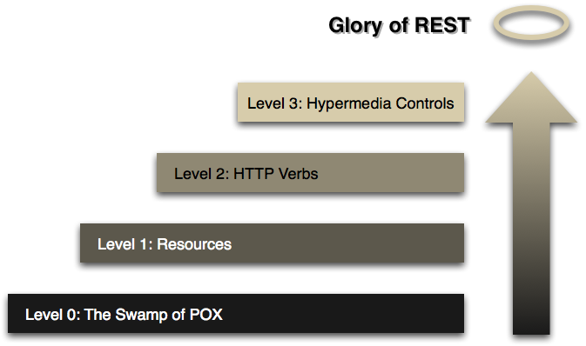
Richardson maturity model

Slide 7
Richardson maturity model (LEVEL 0)
<?xml version="1.0" encoding="ISO-8859-1"?>
<methodCall>
<methodName>sample.sum</methodName>
<params>
<param>
<value><int>17</int></value>
</param>
<param>
<value><int>13</int></value>
</param>
</params>
</methodCall>
One URI, One HTTP method
XML-RPC and most SOAP ws

Slide 8
Richardson maturity model (LEVEL 1)
GET /api/customers
GET /api/suppliers?name=Jack&surname=Sparrow
Many URIs, one HTTP method
Most of 'RESTful' ws that are not

Slide 9
Richardson maturity model (LEVEL 2)
GET /api/customers
POST /api/suppliers
{
"name": "Jack",
"surname": "Sparrow"
}
Many URIs, each supporting multiple HTTP methods

Slide 10
Richardson maturity model (LEVEL 3)
Resources describe their own capabilities and interconnections HATEOAS
Using HATEOAS, we provide the client with links to navigate around the API

Slide 11
Recommendations for better URIs

Slide 12
Naming conventions for URIs
Prefer lowercase letters
Prefer hyphens over underscore
Prefer nouns
Prefer plurals

Slide 13
Don't use verbs in URIs
Bad
Good
/findInventories
/createInventory
/findInventoryById?
GET /inventories
POST /inventories
GET /inventories/{id}

Slide 14
Using hierarchical URIs
GET /trades/5/instruments/10
DELETE /trades/5/instruments/10 GET /trades/5/instruments/10/trades
BAD!!!!! >_<

Slide 15
Some tips for filtering and sorting
/trades?sts=ok&processed=true
/trades/successful
/trades?sts=ok&sort=-amount,+priority

Slide 16
Using HTTP status codes properly
200 ok GET, PUT, PATCH, POST, DELETE
201 created POST
204 no content DELETE
500 server error Any exceptional case
400 bad request Malformed request
404 not found Non-existent resource

Slide 17
Using HTTP status codes properly
401 unauthorized Not authenticated
403 forbidden Not authorized
422 unprocessable entity Validation errors
429 too many requests Overflow rate limit
202 accepted Accepted for processing

Slide 18
Common HTTP methods
Retrieves representation of resource
Response body contains details of requested resource
Idempotent and Safe
GET

Slide 19
Common HTTP methods
Usually used to create a new resource
Can be used to trigger any operation such as validation, authentication, asnc process etc
Usually includes location response header to new resource
Not idempotent and Not safe
POST

Slide 20
Common HTTP methods
Usually used to delete a resource at the specific URI
Can be used to undo or rollback any operation also
Idempotent and Not safe
DELETE

Slide 21
Common HTTP methods
PUT
Usually creates or updates existing resource
Request body contains complete representation
Idempotent and Not safe

Slide 22
Common HTTP methods
Partially updates the existing resource
Request body only contains properties to be updated
Better than PUT to update existing resource
Not necessarily idempotent, although it can be and Not safe
PATCH

Slide 23
Represent errors better
[ {
"error": "AuthenticationError",
"errorCode": -1321,
"localizedMessage": "Incorrect credentials",
"details": "some optional details",
"help": "some helpful link",
"status": 401
}, …
]

Slide 24

Represent errors better
Returning error response with 2xx HTTP response code ?

Slide 25
API versioning
Change is inevitable

Slide 26
Value of versioning
Breaking/non-backward compatible features
Support multiple version API for multiple clients

Slide 27
Options to version an API
URI versioning
Query string versioning
Header versioning
Media type versioning

Slide 28
URI versioning
Easy to implement
Easy to consume
More visible for developers
Hard to upgrade
Hard to go with HATEOAS
/api/v2/trades/1203
HTTP/1.1 OK Content-Type: application/json; charset=utf-8

Slide 29
Query string versioning
Dirty URI
Hard to go with HATEOAS
Not easy to consume and maintain on client side
/api/trades/1203?v=1
HTTP/1.1 OK Content-Type: application/json; charset=utf-8

Slide 30
Custom header versioning
Clean URIs
Hard to go with HATEOAS
Doesn't mix meta-data and resource
/api/trades/1203
HTTP/1.1 OK Content-Type: application/json; charset=utf-8 X-api-version: v1

Slide 31
Media type versioning
Clean URIs
Easy to go with HATEOAS
Hard to implement
Need to introduce custom media type
/api/trades/1203
HTTP/1.1 OK Accept: application/vnd.company.v2+json

Slide 32
HATEOAS
Hypermedia As The Engine Of Application State

Slide 33
HATEOAS
There is no strong constraints to model the representation
Each request represent all possible/relevant operational movements
Hard to implement
Hard to consume
Overcomplicate and overload API response

Slide 34
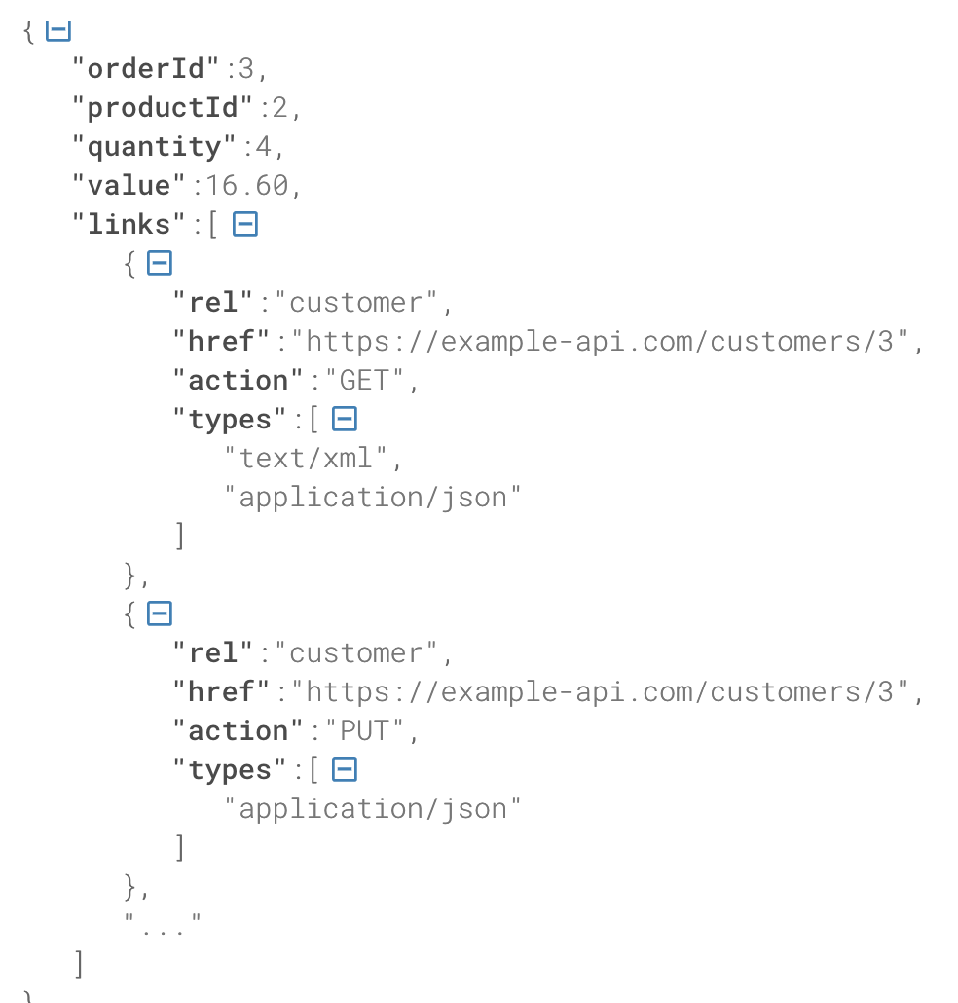
HATEOAS

Slide 35
Before jumping into Code
JAX-RS - specification for RESTful WS
Part of Java EE and defined under JSR-370
Jersey is reference implementation
There are others - RestEasy, Apache CXF etc
Spring MVC doesn't implement JAX-RS, It provides alternative

Slide 36
Coding time

